Slide 1
Face Recognition using SVD
Preetham and Prithvi

Slide 2
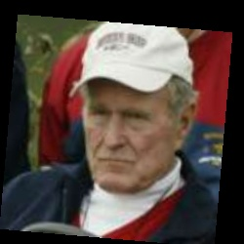
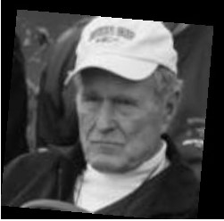
Rgb image to black
and white image
250 X 250 X 3
250 X 250
We convert the original image into a black and white image
so that we can perform SVD on an mxn matrix.

Slide 3
U
S
V
We perform SVD decomposition on the 250x250 image.

Slide 4
U
U_k
Getting the first K columns of the U and storing it as U_k.
We use the U_k as the principle components for predicting.
Then project the training data set into U_k by multiplying
U_k and the training data set.

Slide 5
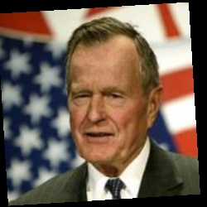
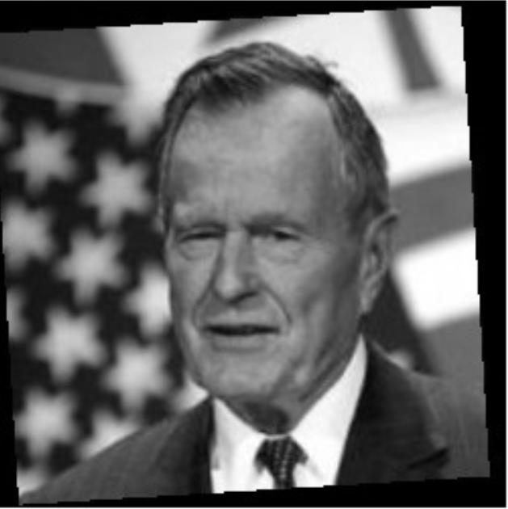
Rgb image to black
and white image
Now we have a test image, we have to recognize the face on this image.
We perform the same operations we have done to all the training images.
At the end, we should be left with another projection matrix for this image.

Slide 6
We then check the distance between all the projections of the training images with the projection of the test image. The lowest distance between two projections will most likely be the same person. By this method we should be able to perform facial identification of a person.
≈

